Slide 1
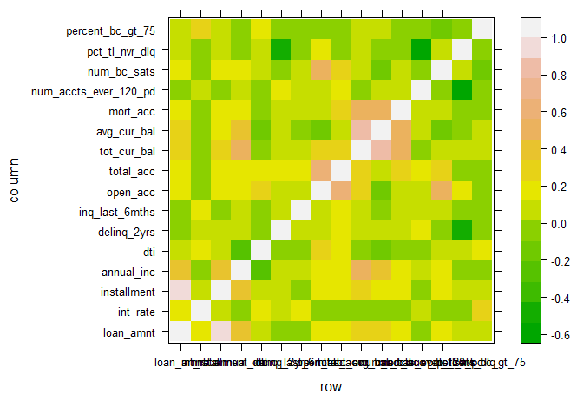
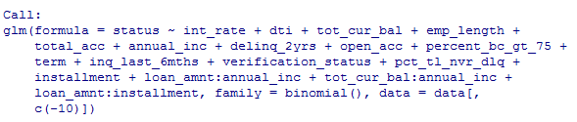
1st: Method: GLM
In cleaned data, there are 16 numerical predictors and 6 categorical predictors.
Use correlation plot of numerical predictors to seek interactions with abs(correlation) >0.5
Build GLM based only on numerical predictors and drop insignificant terms
Combine numerical terms and their interaction with each categorical predictor in different GLM, e.g. numerical terms+numerical terms: some categorical, and use drop-in deviance test to determine whether a categorical predictor is useful
Relevel categorical predictor and combine all interactions into the full model
Forward selection of 20 terms based on AIC starting from intercept-only model.
Determine the classifier to obtain categorical fitted value.
Prediction accuracy = 0.804

Slide 2
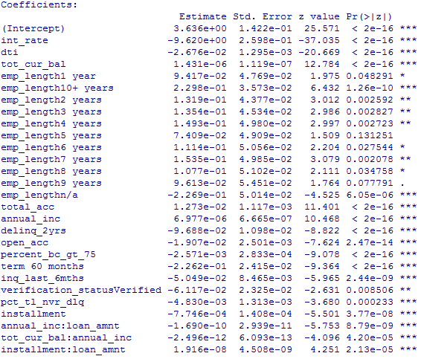
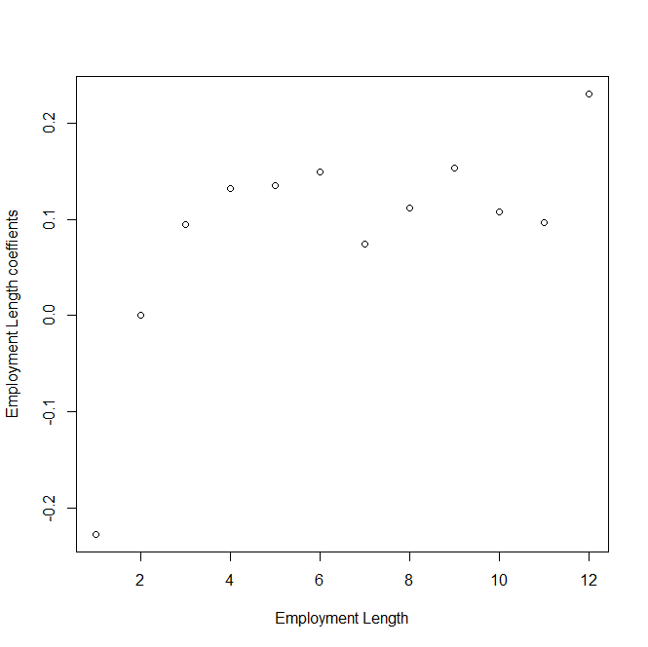
Some interpretation of coefficients:
Annual income has positive coefficient, meaning higher income indicates larger capacity to repay;
Lower interest rate indicates larger capacity to repay;
Employment length:

Slide 3
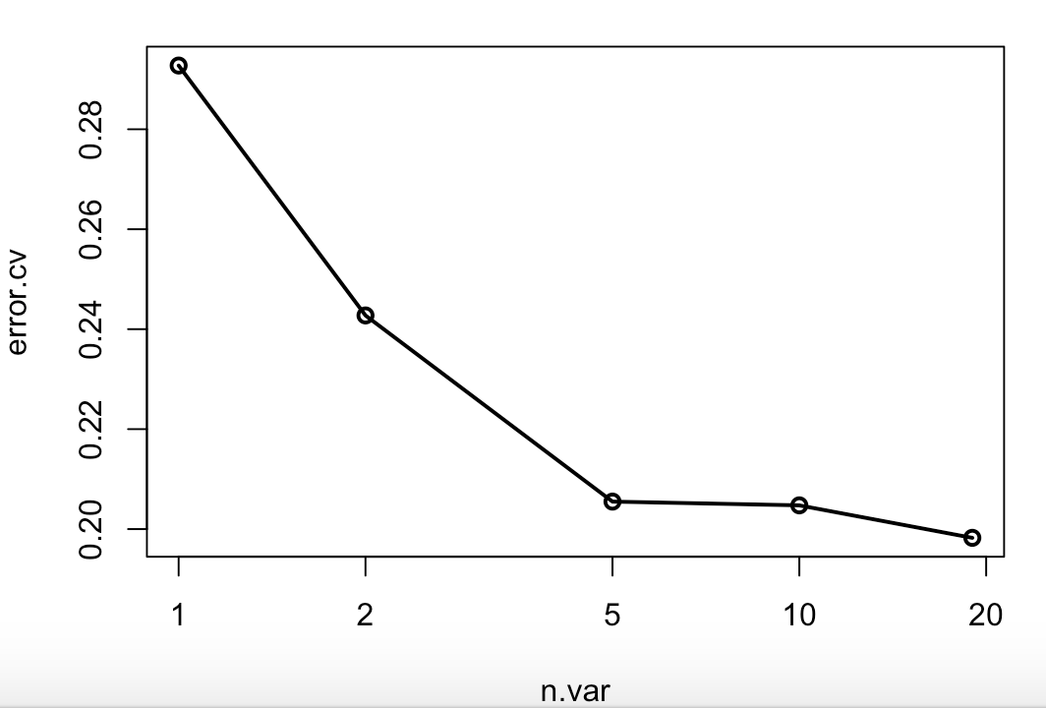
2nd Method: RandomForest
5 fold Cross-Validations for feature selection.
Check importance plot and remove non-significant predictors.
Rebuild model with 12 predictors

Slide 4
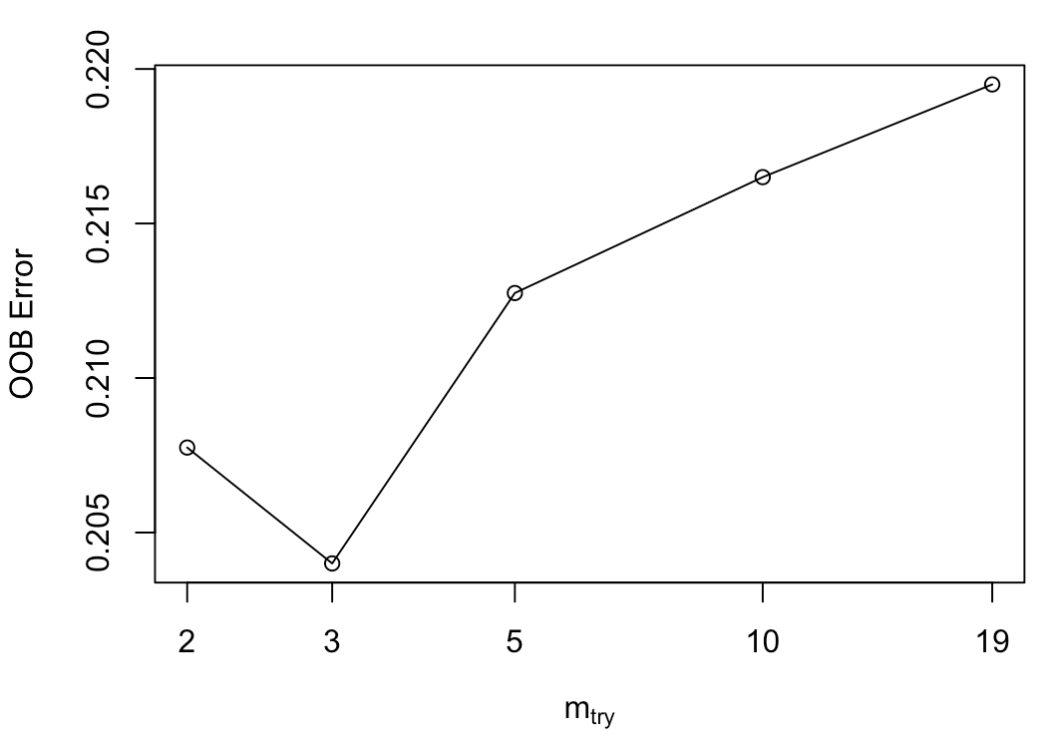
Tune RandomForest for the optimal mtry parameter
Optimal Parameter：
ntree = 500, number of trees to grow
mtry = 3, number of variables randomly sampled as candidates at each split.
Prediction accuracy = 0.804

Slide 5
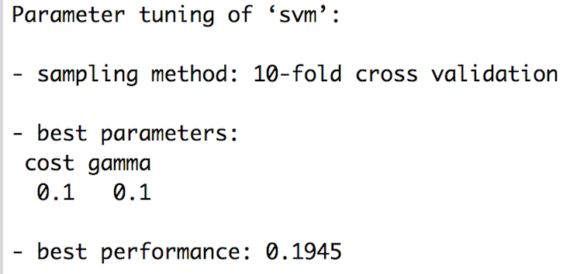
3rd Method: SVM with RBF kernel
We normalized the dataset (training and testing) for SVM. SVMs assume that the data it works with is in a standard range (0 to 1 roughly). So the normalization of feature vectors prior to feeding them to the SVM is very important. We want to make sure that for each dimension, the values are scaled to lie roughly within this range.
We selected optimal parameters (the cost and gamma) by 10-folds CV.
Train the model with optimal parameters(cost = 0.1, gamma = 0.1) with 10-folds CV.
Prediction accuracy = 0.8055

Slide 6
4th Method: AdaBoosting and Bagging
adaBoosting with total 50 iterations for which the number of trees to use. Additionally, a bootstrap sample of the training set is drawn using the weights for each observation on that iteration.
adaBoosting Prediction accuracy = 0.797
Bagging Prediction accuracy = 0.804

Slide 7
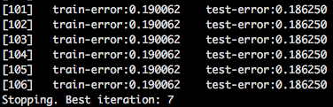
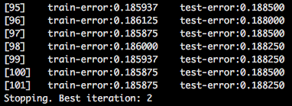
5th Method: Extreme Gradient Boosting
Tree Booster converged at 7th iteration
Optimal Parameters for Tree/Linear Booster:
eta = 0.001 (control the learning rate), which used to prevent overfitting by making the boosting process more conservative. (for tree only)
max.depth = 4，maximum depth of a tree (for tree only)
subsample = 0.8, randomly collected 80% of the data instances to grow trees and this will prevent overfitting.
Linear Booster converged at 2th iteration

Slide 8
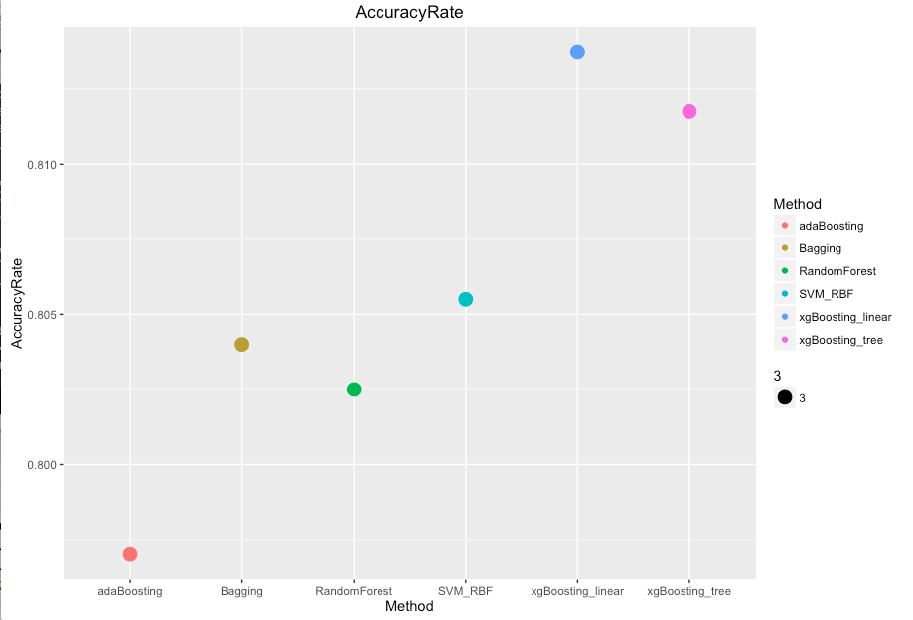
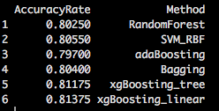
Final Result

